Slide 1
Child Care Costs

Slide 2
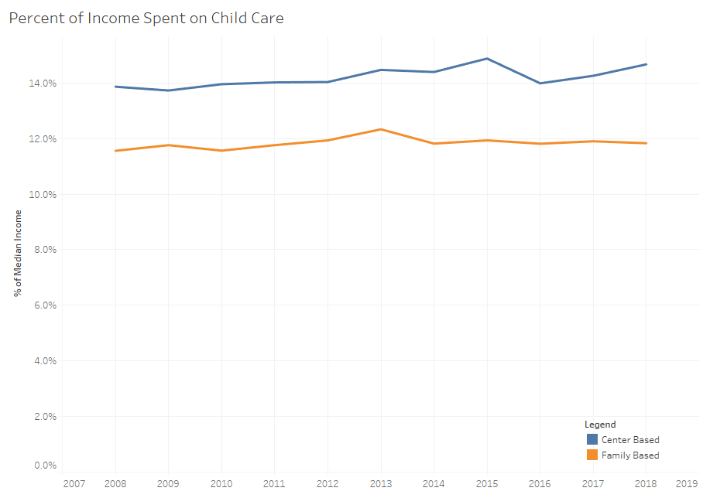
Increasing Costs
Nationally Child Care costs have been increasing nation wide
Center based childcare increased by 0.8% ($1,545) per child
Family based childcare increased by 0.27% ($1,090) per child

Slide 3
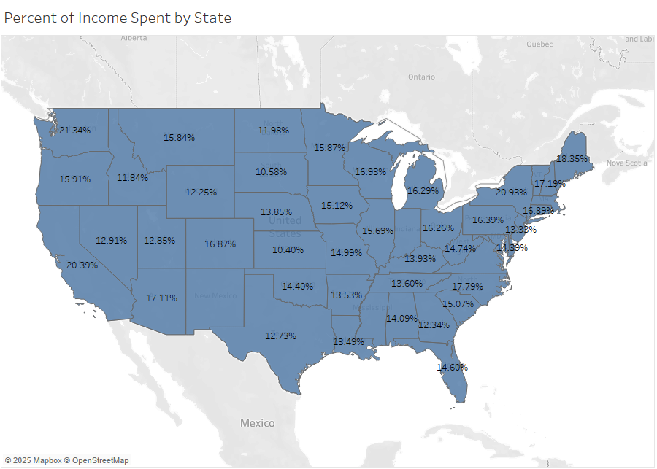
National Cost in 2018
Massachusetts ranks 5th in the nation in most expensive childcare
The national average cost of childcare is $7,317 in 2018
Massachusetts was almost double that at $13,884

Slide 4
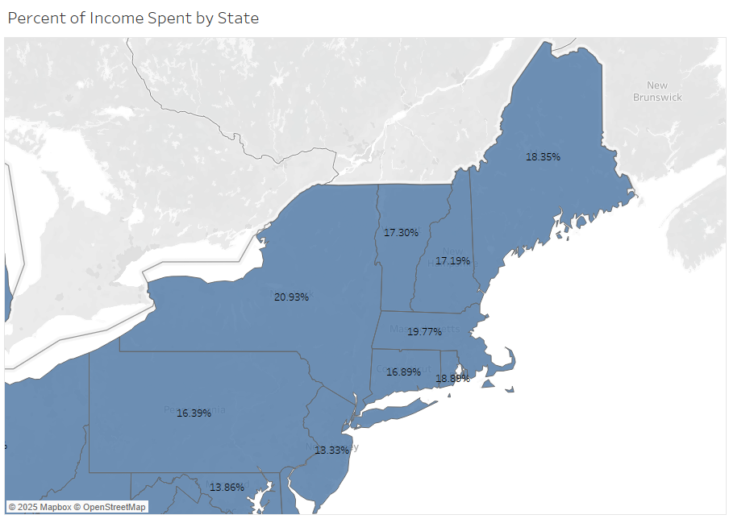
North East Cost in 2018
Massachusetts has the 2nd highest percent of income spent on childcare in the northeast
The average cost in the northeast is $8,631
Massachusetts childcare costs are $3,600 more than average

Slide 5

Massachusetts Costs
Center based Increased 0.2% ($2,158.00) over the last 10 years
In 2017 and 2018 there was a large increase in median income
This decreased the percent spent on childcare despite an increase in costs

Slide 6
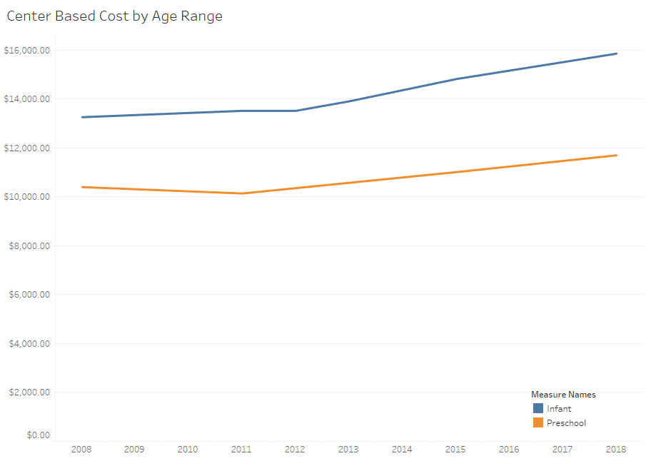
Massachusetts Costs
Infants have the highest cost, almost $16,000
Costs drop as the child gets older, almost $12,000
Preschool age children cost around $4,000 less per year in childcare

Slide 7
Assistance Options
Option 1: Provide assistance for childcare for the first year or two
  Larger companies may want to look at a company daycare
  Smaller companies may want to look at a partial reimbursement for expenses
Option 2: Help push new tax laws to allow for deductions of childe care costs

